Slide 1
Blacktown Chinese Christian Church
Welcome to Our English Service 05.10.2025
English Service 9:45 – 11:00 am
Worship Songs: Passage: Speaker: Topic: Response Song: Announcements and Closing Prayer Benediction
Lay Me Down T TBA TBA TBA

Slide 2
BCCC english service

Slide 3

Please keep all phones on silent

Slide 4
Lay Me Down
放下我
CCLI Licence No: 5485849
CCLI许可证号：5485849

Slide 5
With this heart open wide

Slide 6
我心完全敞开

Slide 7
From the depths, from the heights

Slide 8
深处高处都献上

Slide 9
I will bring a sacrifice

Slide 10
我必来献上祭物

Slide 12
With these hands lifted high

Slide 13
我双手都高举起

Slide 14
Hear my song, hear my cry

Slide 15
请听我歌, 听我哭

Slide 16
I will bring a sacrifice

Slide 17
我必来献上祭物

Slide 18
I will bring a sacrifice

Slide 19
我必来献上祭物

Slide 20
I lay me down, I'm not my own

Slide 21
我降服放下, 不属自己

Slide 22
I belong to You alone

Slide 23
我单单属你一人

Slide 24
Lay me down, lay me down

Slide 25
放下我, 放下我

Slide 27
Oh, hand on my heart

Slide 28
哦, 手放我心上

Slide 29
This much is true

Slide 30
这真是真理

Slide 31
There's no life apart from You

Slide 32
离了你我无生命

Slide 33
Lay me down, lay me down

Slide 34
放下我, 放下我

Slide 35
Letting go of my pride

Slide 36
放下我一切骄傲

Slide 37
Giving up all my rights

Slide 38
放弃所有权利

Slide 39
Take this life and let it shine, shine, shine

Slide 40
愿这生命发光发光发光

Slide 41
Take this life and let it shine

Slide 42
愿这生命让它发光

Slide 43
I lay me down, I'm not my own

Slide 44
我降服放下, 不属自己

Slide 45
I belong to You alone

Slide 46
我单单属你一人

Slide 47
Lay me down, lay me down

Slide 48
放下我, 放下我

Slide 50
Oh, hand on my heart

Slide 51
哦, 手放我心上

Slide 52
This much is true

Slide 53
这真是真理

Slide 54
There's no life apart from You

Slide 55
离了你我无生命

Slide 57
Lay me down, lay me down

Slide 58
放下我, 放下我

Slide 59
Oh, lay me down, lay me down

Slide 60
哦, 放下我, 放下我

Slide 61
It will be my joy to say

Slide 62
我喜乐地这样说

Slide 63
"Your will, Your way"

Slide 64
"你意你路"

Slide 65
It will be my joy to say

Slide 66
我喜乐地这样说

Slide 67
"Your will, Your way"

Slide 68
"你意你路"

Slide 69
It will be my joy to say

Slide 70
我喜乐地这样说

Slide 71
"Your will, Your way, always"

Slide 72
"你意你路, 永远"

Slide 75
It will be my joy to say

Slide 76
我喜乐地这样说

Slide 77
"Your will, Your way"

Slide 78
"你意你路"

Slide 79
It will be my joy to say

Slide 80
我喜乐地这样说

Slide 81
"Your will, Your way"

Slide 82
"你意你路"

Slide 83
It will be my joy to say

Slide 84
我喜乐地这样说

Slide 85
"Your will, Your way, always"

Slide 86
"你意你路, 永远"

Slide 87
I lay me down, I'm not my own

Slide 88
我降服放下, 不属自己

Slide 89
I belong to You alone

Slide 90
我单单属你一人

Slide 91
Lay me down, lay me down

Slide 92
放下我, 放下我

Slide 94
Oh, hand on my heart

Slide 95
哦, 手放我心上

Slide 96
This much is true

Slide 97
这真是真理

Slide 98
There's no life apart from You

Slide 99
离了你我无生命

Slide 100
Lay me down, lay me down

Slide 101
放下我, 放下我

Slide 103
I lay me down, I'm not my own

Slide 104
我降服放下, 不属自己

Slide 105
I belong to You alone

Slide 106
我单单属你一人

Slide 107
Lay me down, lay me down

Slide 108
放下我, 放下我

Slide 110
Oh, hand on my heart

Slide 111
哦, 手放我心上

Slide 112
This much is true

Slide 113
这真是真理

Slide 114
There's no life apart from You

Slide 115
离了你我无生命

Slide 116
Lay me down, lay me down, oh

Slide 117
放下我, 放下我, 哦

Slide 118
Lay me down, lay me down, oh

Slide 119
放下我, 放下我, 哦

Slide 120
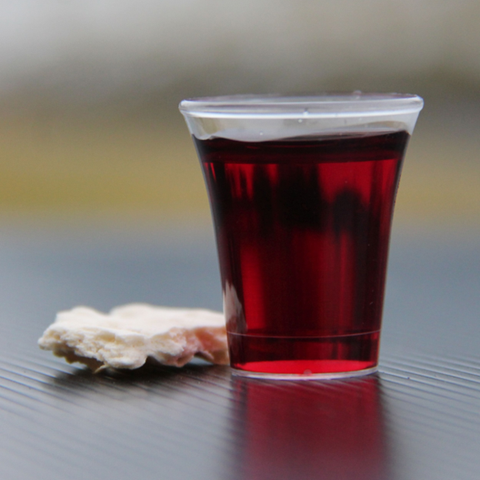
Holy Communion

Slide 121

Bible reading

Slide 122
T (NIV)
T

Slide 123
Scripture quotations taken from The Holy Bible, New International Version® NIV®
Copyright © 1973, 1978, 1984, 2011 by Biblica, Inc.
Used with permission. All rights reserved worldwide.

Slide 124
Announcements

Slide 125





Account name: Blacktown Chinese Christian Church
Account number: 4216 50263
Offering
BSB: 112 - 879
Please put in "offering" as the reference
The offering box is available at the back of the hall

Slide 126
Prayer points

Slide 127
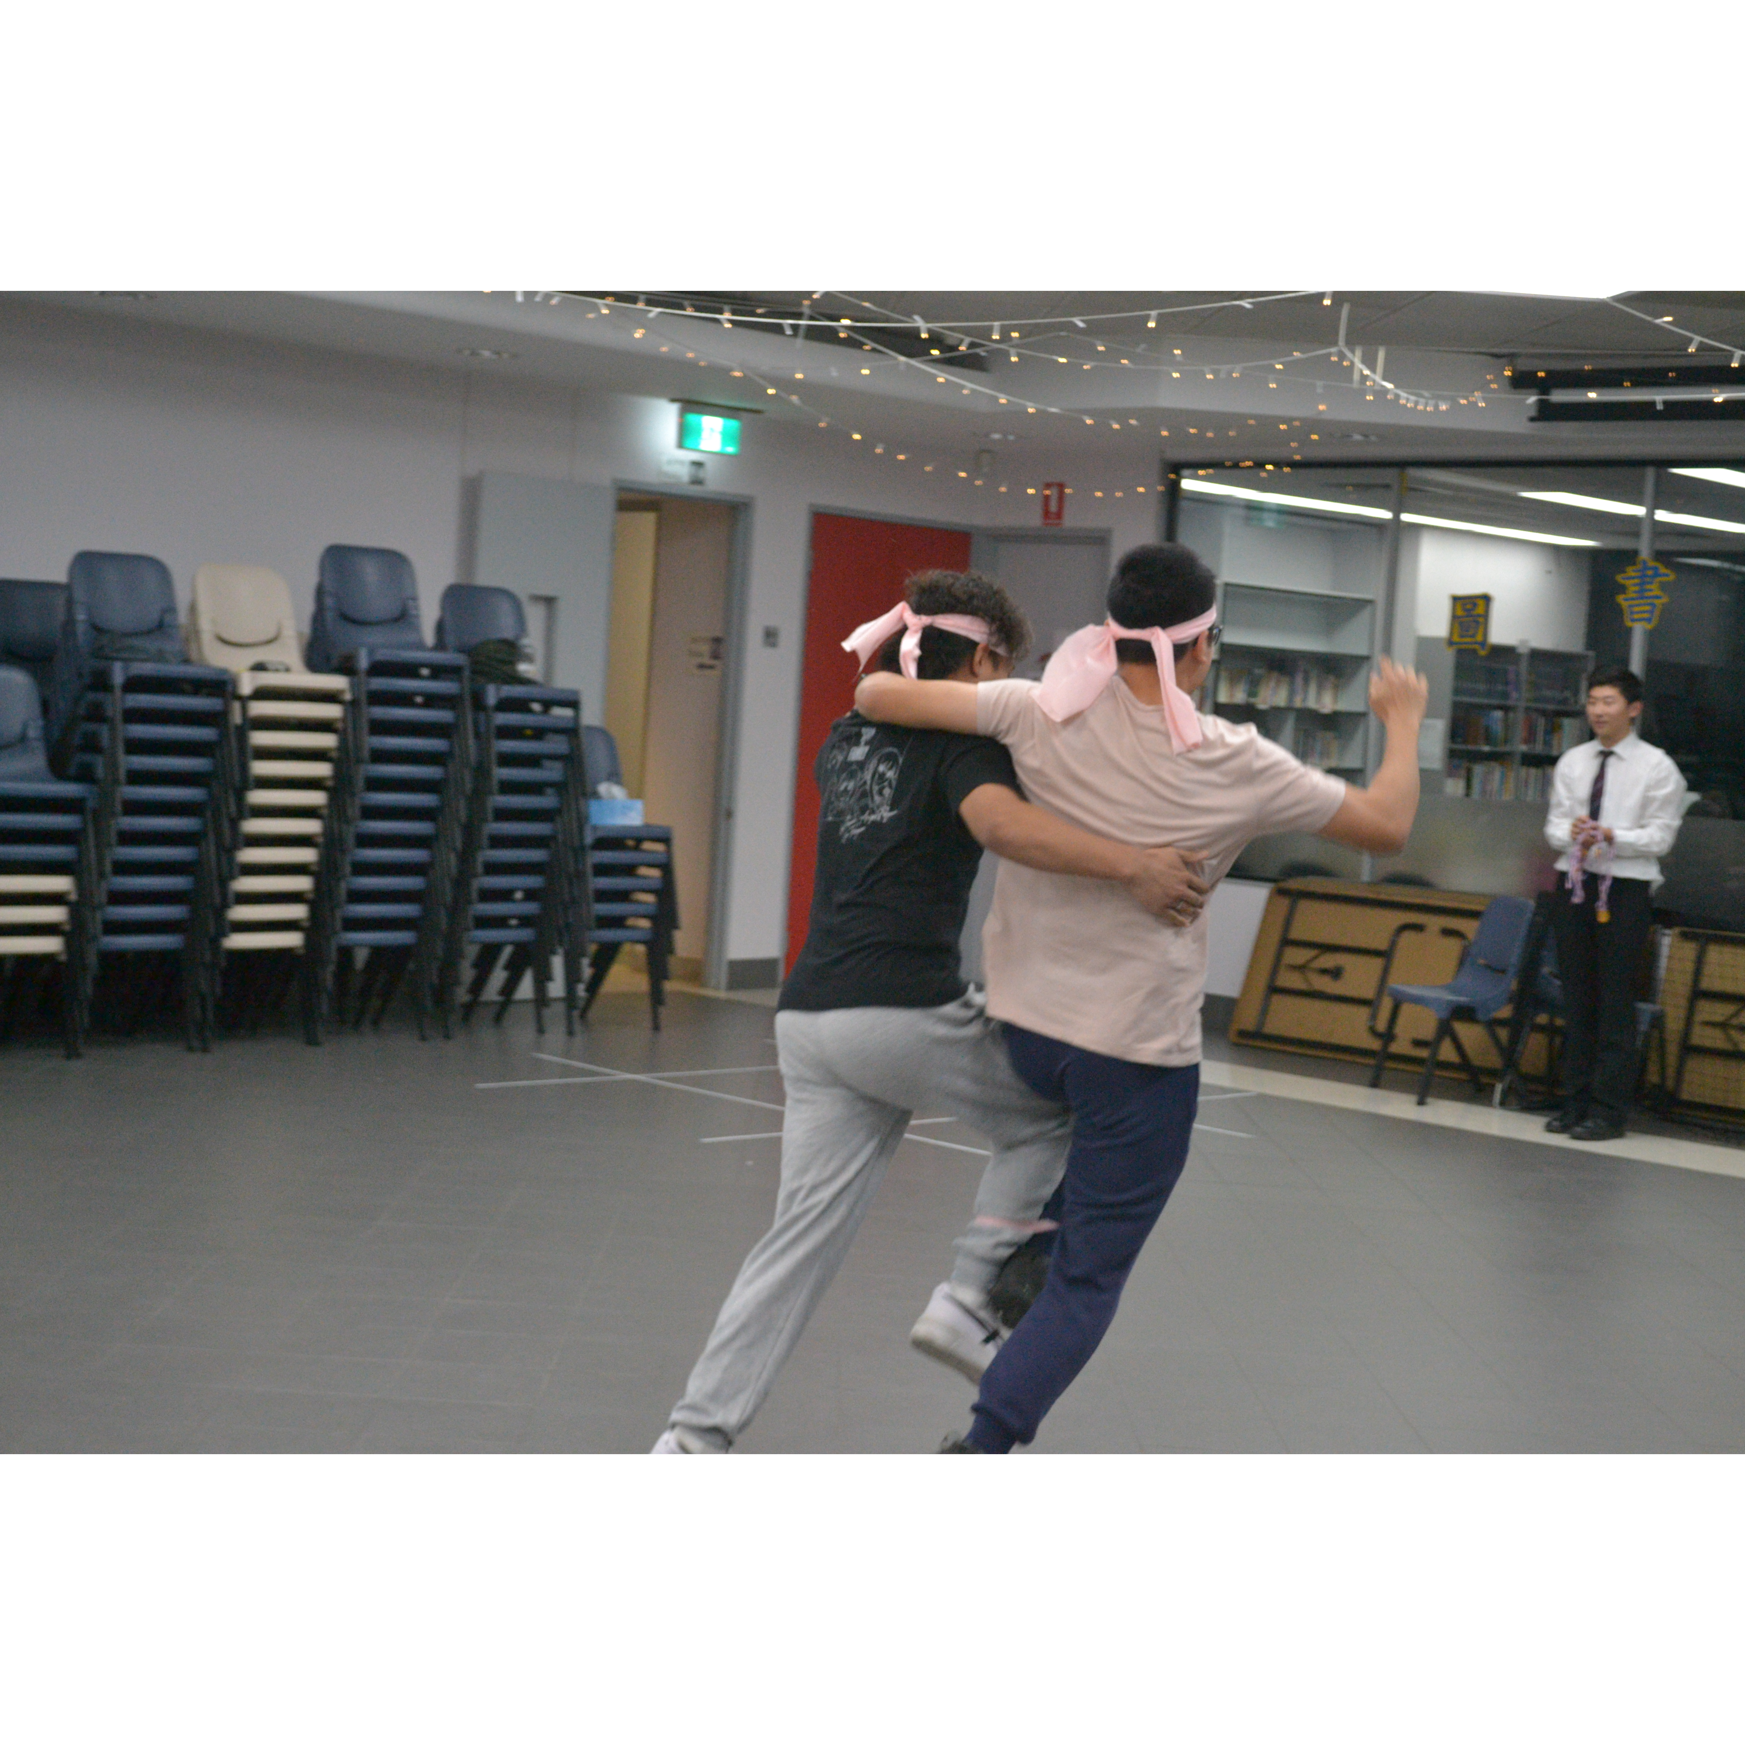
Mingle time!

